Slide 1
Comparing New York and Toronto Neighborhoods
By Anton Anonymous
The XYZ Corp is looking forward to relocate part of its business operations from NY city to Toronto.
Among many business considerations is one voiced by HR department.
Bussiness nature of XYZ corp will require moving number of employees from NY city to
Toronto.
HR is concerned about cultural and quality of life changes for these
employees that will move to Toronto.

Slide 2
Information on cultural and lifestyle similarities between Toronto and New York is not readily available and is not easily measurable.
Data Sources
Foursquare API endpoints provide venue database for both Toronto and New York.This database has over sixty descriptive attributes that very well describe each venue.Borough and neighborhood data for both cities is readily available from many sources such as https://geo.nyu.edu/catalog/nyu_2451_34572.These sources will provide venue data and venue selection within city centre radius.
Python geopy.geocoders package provides tools for geolocation of cities.

Slide 3
Feature selection
For lookup of neighborhoods of Toronto and New York : Borough, Neighborhood, Latitude and Longitude were used.
Foursquare API venues endpoint provided venues: name , category,lattitude and longitude.
Venue category was used to create feature set.
Methodology
I used k-means clustering analysis on cities neighborhoods to determine similarities between Toronto and New York neigborhoods in their venues.
For each neighborhood I derived new feature - mean of category for that neighborhood.
I expected that if calculated clusters contain proportional number of neighborhoods from both cities it will be safe to claim that living in both cities is quite similar.

Slide 4
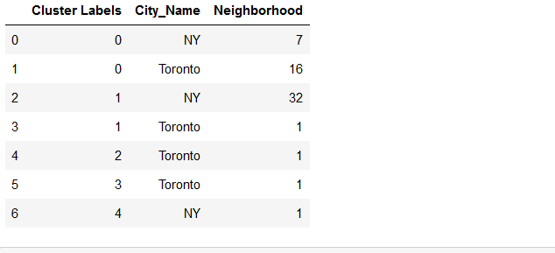
Results
Neighborhoods were grouped to 5 clusters.
2 clusters were unique for Toronto and 1 for New York.
These contained together only 3 neighborhoods of 59 in both cities.

Slide 5
HR is concerned about relocating its employees from New York to Toronto.
One of the aspects of possible relocation to consider is if living and lifestyle of both
these cities is similar. By analyzing neighborhood venues for both cities I found out
that in this aspect these cities are quite similar and HR should not be overly concerned
about differences.
Conclusion
Both New York and Toronto are quite similar to live in. There are three neigborhoods that stand out, further analysis of these may be performed if necessary.

